Slide 1

Sociology Department Meeting
Tuesday, September 17, 2024

Slide 2
Sociology Department - Agenda
Minutes are embedded in the PowerPoint in red boxes.
In attendance: Chris Gold, Stacey Allen, Melissa Fujiwara, Martin Leyva, Kassia Wosick, Corina Diaz, Mediha Din, Sue Dowden, and Kell Stone.
SLOs – Spring and Fall 2024
Fall Enrollment and Scheduling
Committee Membership
Curriculum Review
Evaluations
Updating Pathways

Slide 3
SLO Assessment
Kassia emailed everyone every one last week re: SLOs. The Google spreadsheet is set up. All courses and sections will use Canvas outcomes, which will allow for analysis of disaggregated data in a meaningful way. The department will decide whether to continue to use the Google spreadsheet, or to just use it for PLOs and Program Review. Kassia will create a template. All full-time faculty should have access to Nuventive.
In terms of scheduling, 107H and 113H will be offered on a staggered two-year rotation. 107H will be offered on a two-year rotation starting in Fall 2025 – odd years. (In Spring there are two sections of 107 – an FYE section and section for the general population). 113H will be put on a Fall two-year rotation starting Fall 2026 – even years.
Spring 2024
All completed and entered.
Data not received for:
  Sociology 102, James Thing (section 2964)
  Sociology 104, Michelle Bell-Blossom (section 2973)
  Sociology 112, Sacramento Mendoza Ramos (section 2988)
Fall 2024
  SOCI 101 SLO 1
  SOCI 101H SLO 1
  SOCI 107 & 107H SLO 1
  SOCI 109 SLO 1
  SOCI 118 SLO 1
  WSTU 1 SLO 1

Slide 4
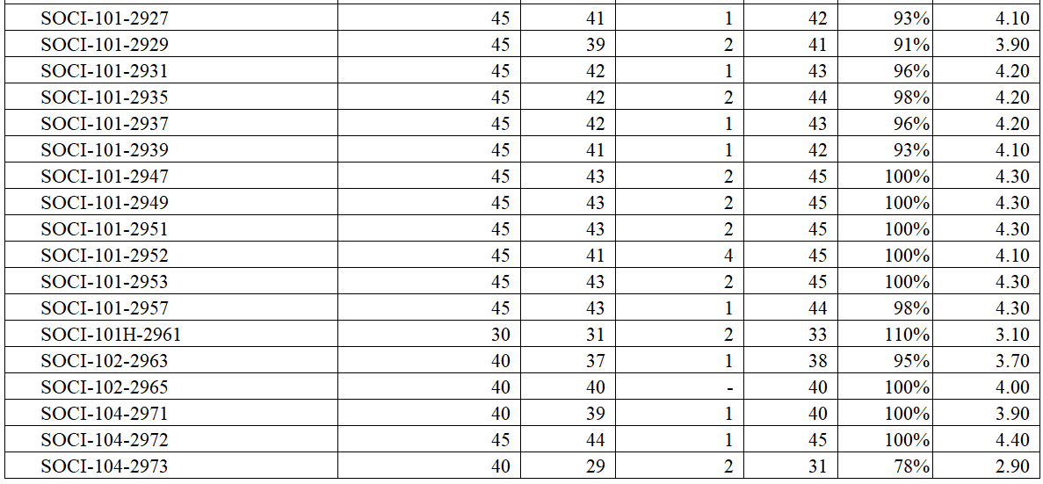
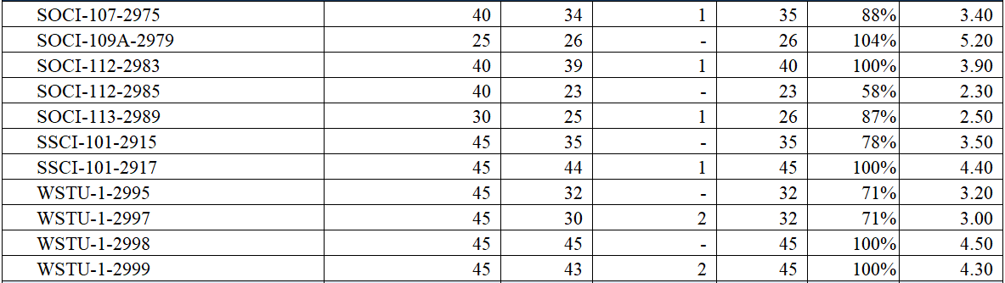
Fall Enrollment and Spring Scheduling – Online possible fraud
Number of students enrolled
Fill Rate

Slide 5
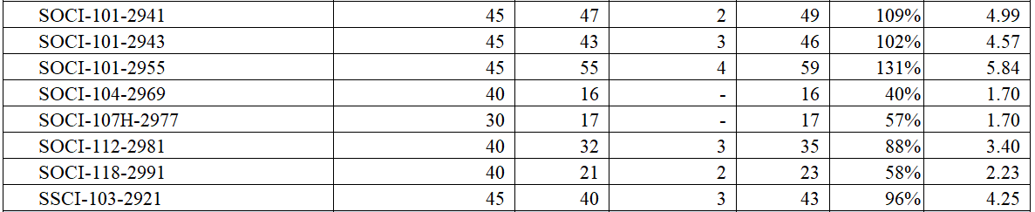
Fall Enrollment and Spring Scheduling – On Campus possible fraud
On Campus sections had a large number of drops for No Shows, likely because of fraud.
Number of students enrolled
Fill Rate

Slide 6
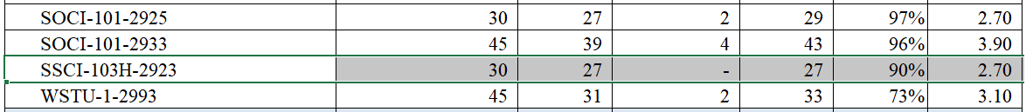
Fall Enrollment and Spring Scheduling – Hybrid

Slide 7
Committee Membership
Division Council – Stacey Allen
Load Committee – Kassia Wosick
BSS Division Curriculum Committee – Melissa Fujiwara
Assessment Committee – Kassia Wosick
Annual Plan – Stacey Allen
FIRST – Martin Leyva
Student Success – Martin Leyva

Slide 8
Curriculum Review – Fall 2024
Melissa explained Common Course Numbering which impact Sociology in Fall 2025, with Sociology 101. Courses will be required to use a common Course Outline of Record that will be decided at the state level. Departments will be given a template that they must use for their COR.
Melissa suggested that they keep an eye out for non-credit courses that may be created in their discipline. They may consider writing some non-credit courses.
All of the curriculum review is completed. Sociology 113H was held up by the Articulation Officer with a request for different assignments to justify the Honors designation.
Sociology 101H – Introduction to Sociology Honors
Sociology 102 – Families and Intimate Relationships
Sociology 113H – Gender and Society Honors (New)
Sociology 117 – Drugs, Alcohol and Society (New)
Women’s Studies 1 – Introduction to Women’s Studies
[Common Course Numbering – Coming Fall 2025 for SOCI 101]

Slide 9
Faculty Evaluations
Keep an eye on your email and let Cecelia and I know if you get an email from Trakstar that is incorrect.

Slide 10
Faculty Evaluations
Everyone who is being evaluated or is evaluating should have received and email from Cecelia. Let Cecelia and I know if you get an email from Trakstar that is incorrect.

Slide 11
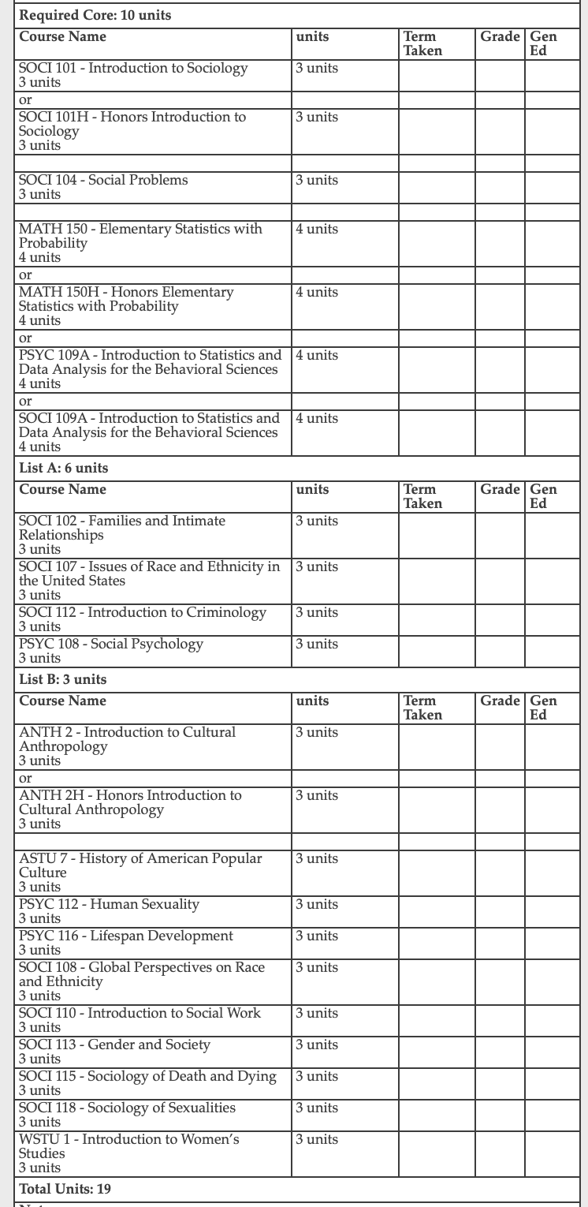
Updating the Sociology AAT Pathway
Due Date: October 18
Please:
Review your degree and see if any changes are needed.
Review the order of courses and indicate any changes (please keep transfer-level Math and English in the first year).
Narrow down the choices for all the green and yellow boxes to 3-4 choices.
Review the course information provided by the Dean to inform your decisions.

Slide 12
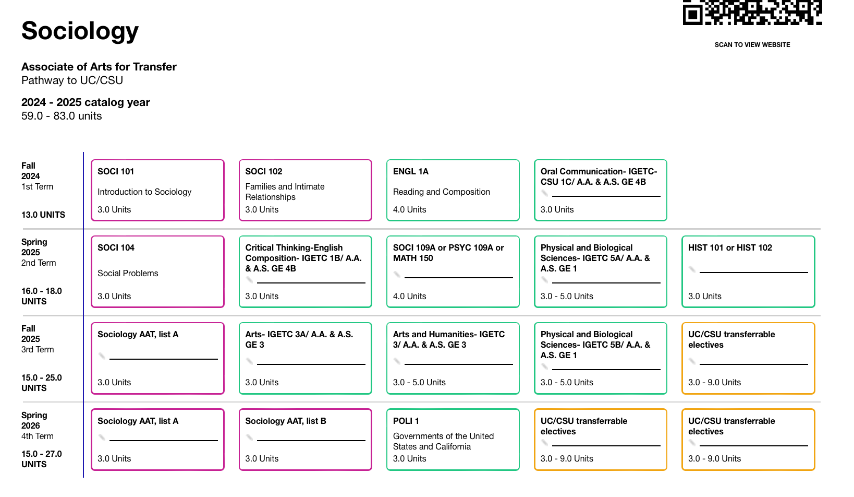
Updating the Sociology AAT Pathway
Due Date: October 18
Please:
Review your degree and see if any changes are needed.
Review the order of courses and indicate any changes (please keep transfer-level Math and English in the first year).
Narrow down the choices for all the green and yellow boxes to 3-4 choices.
Review the course information provided by the Dean to inform your decisions.

Slide 13
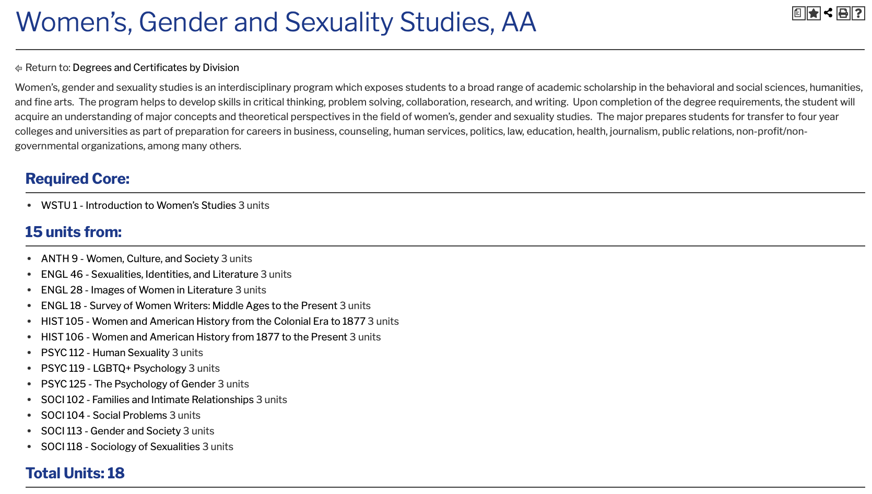
Women, Gender and Sexuality Studies
Chris asked whether it is time to create a WGS transfer degree. The department decided to stick with the AA degree. The AAT falls under the umbrella of Social Justice Studies but would still be housed in Sociology and carry the same name. The ECC WGS degrees was the first of its kind in the CCCs.
Due Date: October 18
Please:
Review your degree and see if any changes are needed.
Review the order of courses and indicate any changes (please keep transfer-level Math and English in the first year).
Narrow down the choices for all the green and yellow boxes to 3-4 choices.
Review the course information provided by the Dean to inform your decisions.

Slide 14
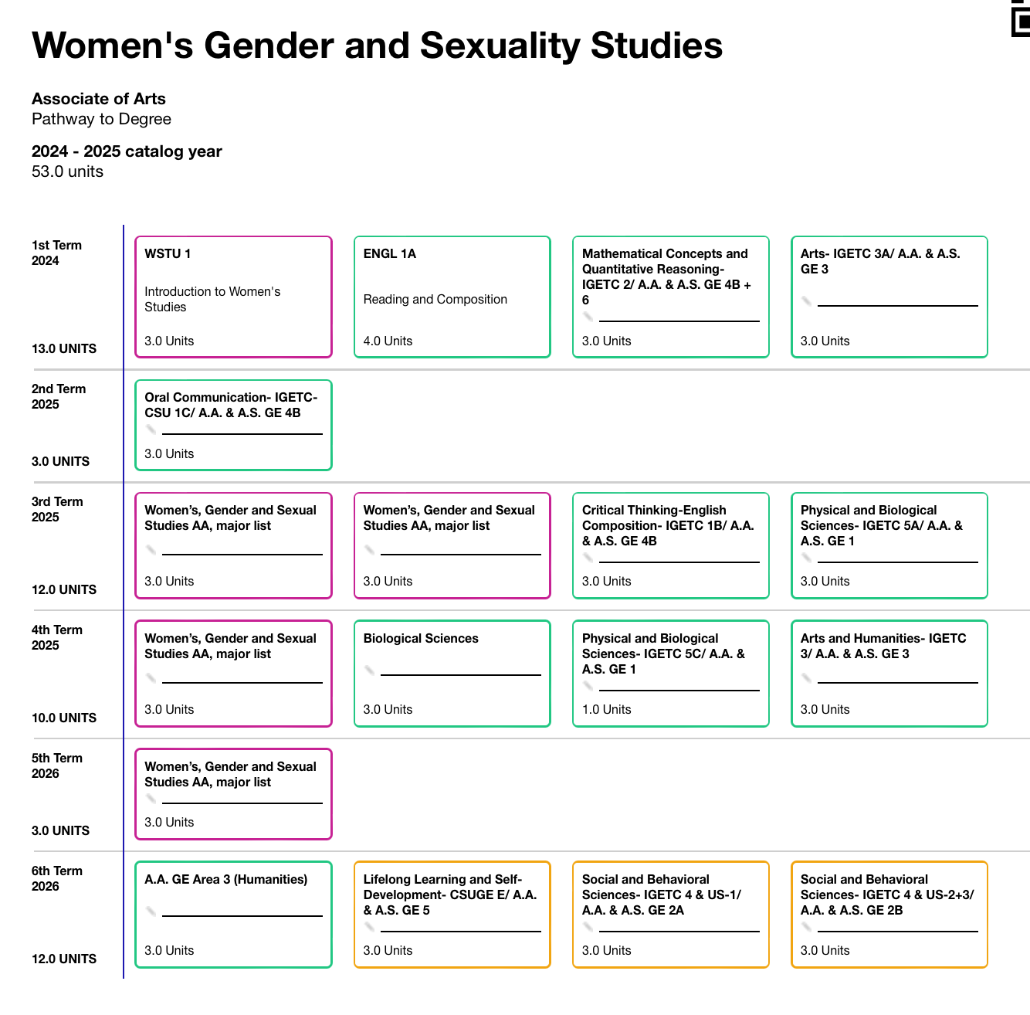
Women, Gender and Sexuality Studies
(time for an AAT?)
Due Date: October 18
Please:
Review your degree and see if any changes are needed.
Review the order of courses and indicate any changes (please keep transfer-level Math and English in the first year).
Narrow down the choices for all the green and yellow boxes to 3-4 choices.
Review the course information provided by the Dean to inform your decisions.

Slide 15
