Slide 1

Public Safety Training Center
COMMUNITY PRESENTATION
April 6, 2022

Slide 2
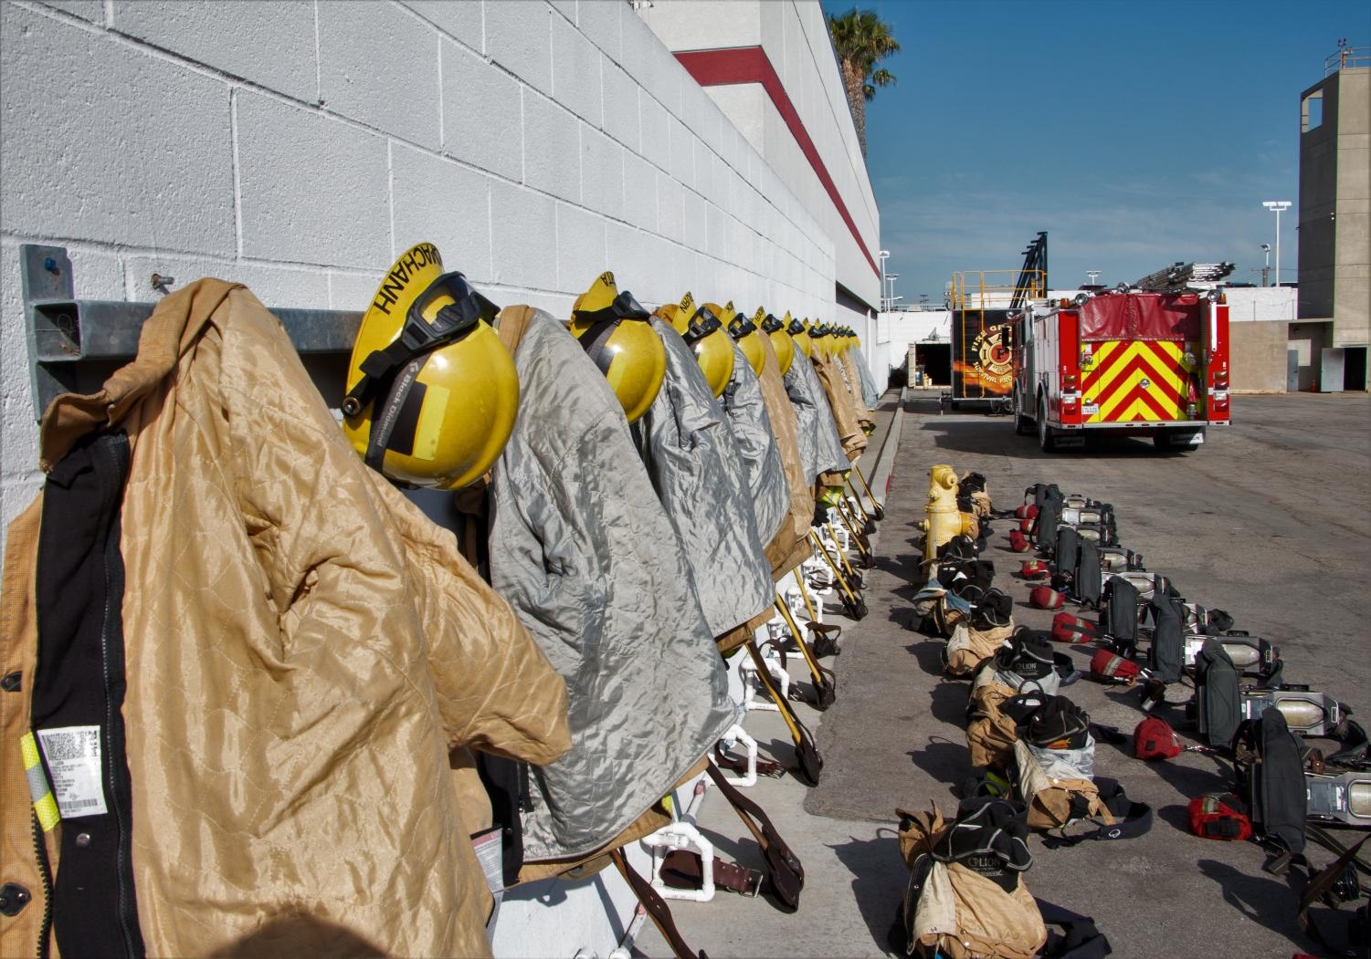
The Public Safety Training Center
California Fire Marshal approved
Has trained South Bay firefighters for 50+ years
Graduates of the El Camino Public Safety Training Center have been hired throughout the county, state and nation
Trains 70-80 recruits each year
One of only four such facilities in the area

Slide 3
The Need
Fire Departments from throughout the South Bay currently travel 25 miles away to Rio Hondo College to train
  Longer response times
  Less efficient
  More expensive
Local firefighter and EMT recruits have to leave the South Bay to complete their educations
El Camino College’s Public Safety Training Center needs expanded facilities to handle increasing demand for the program

Slide 4
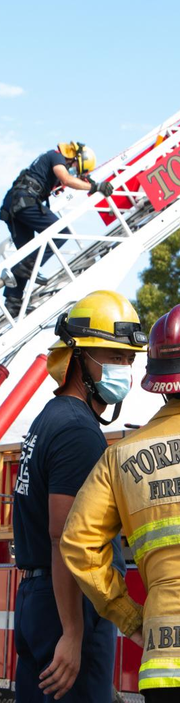
The Project
Located on existing parking lot
Proposed PSTC facilities:
  New Classrooms
  Showers / Lockers / Restrooms
  Multipurpose Room
  Fire Tower
  Burn Room
  Fire Apparatus Storage Building (Five Bays)
  Administration Office
  Physical Training

Slide 5
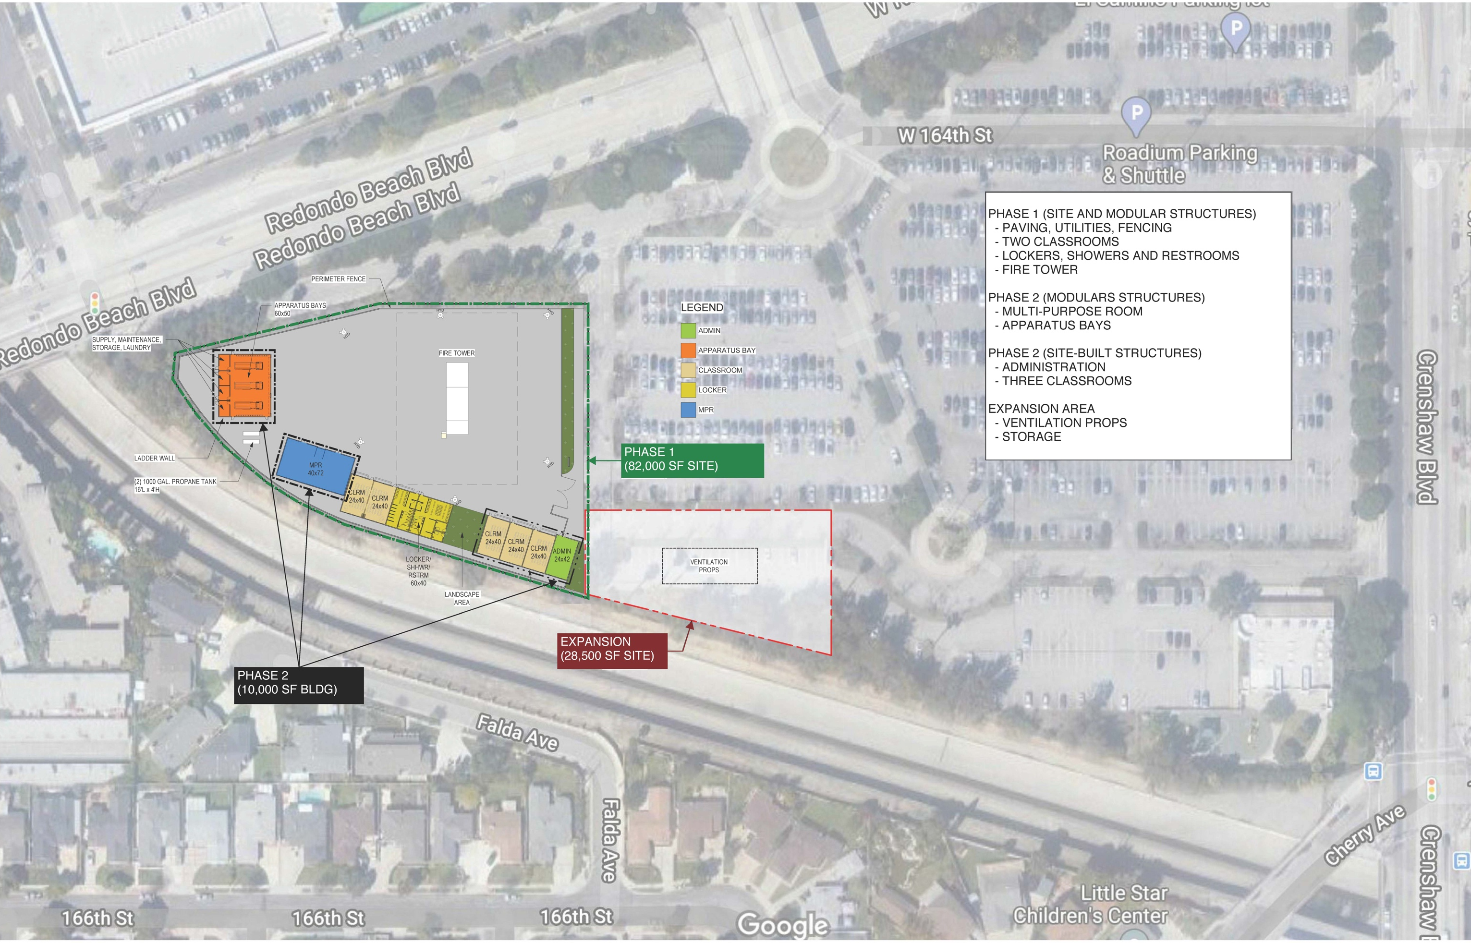
Notes:
Review each project element and how it will be used – emphasize the building placement to shield residents

Slide 6
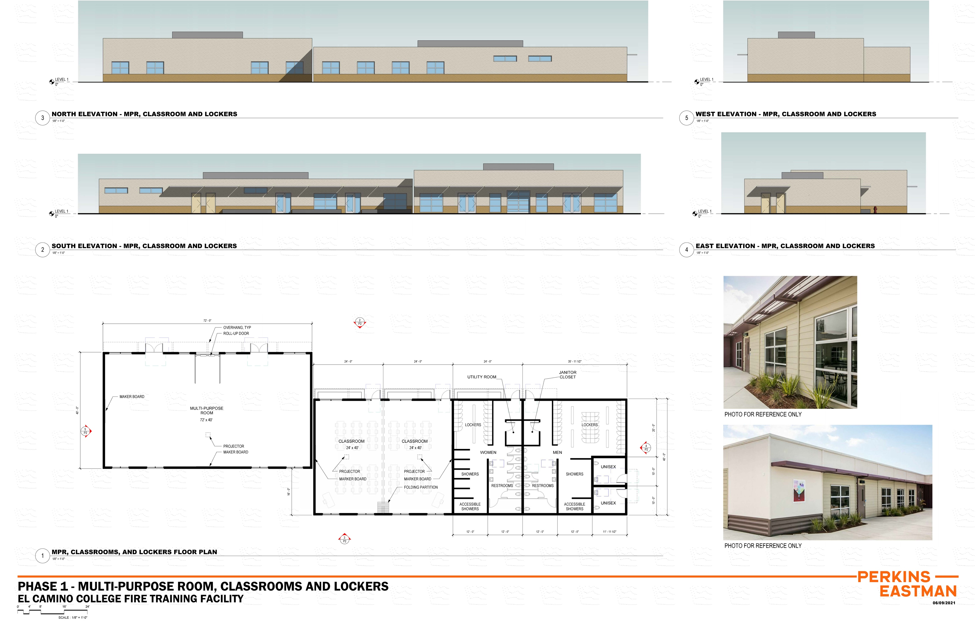

Slide 7
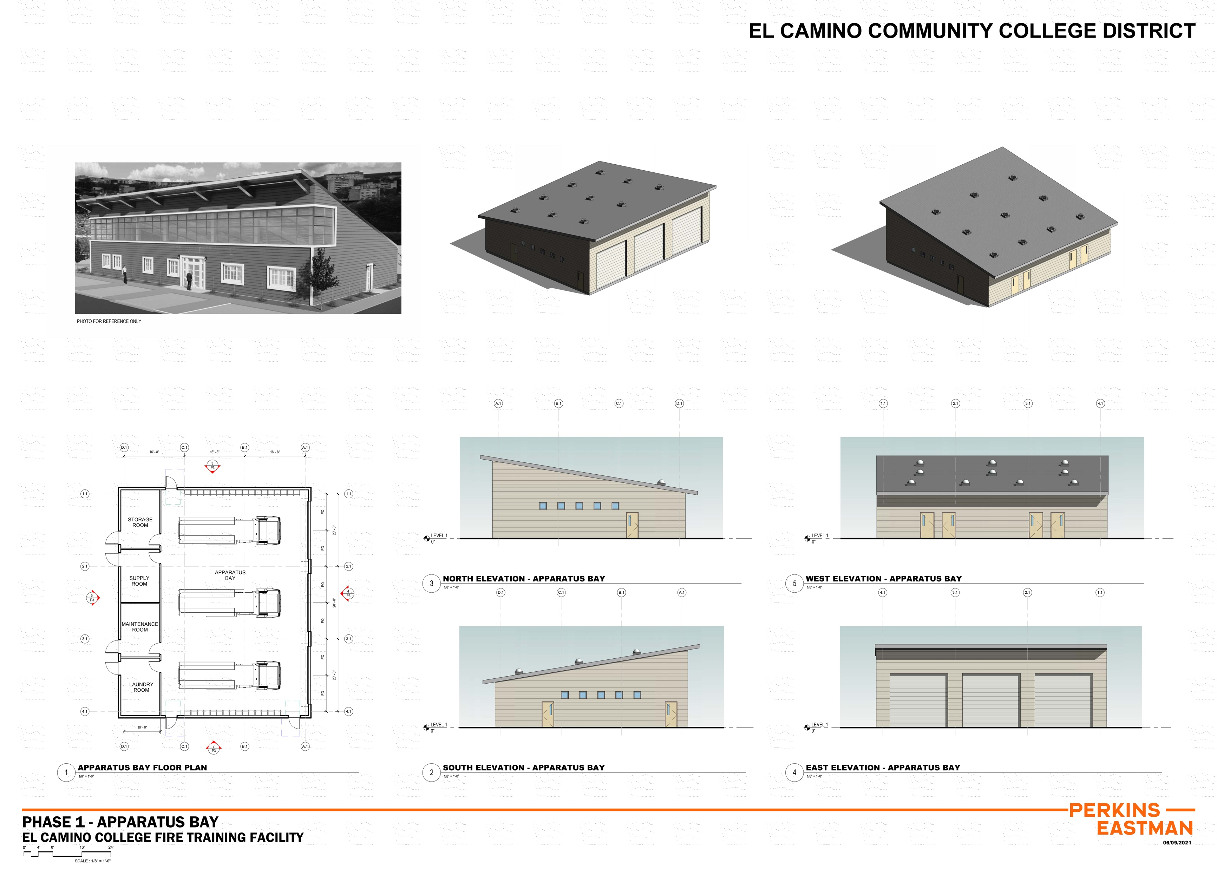

Slide 8


Slide 9
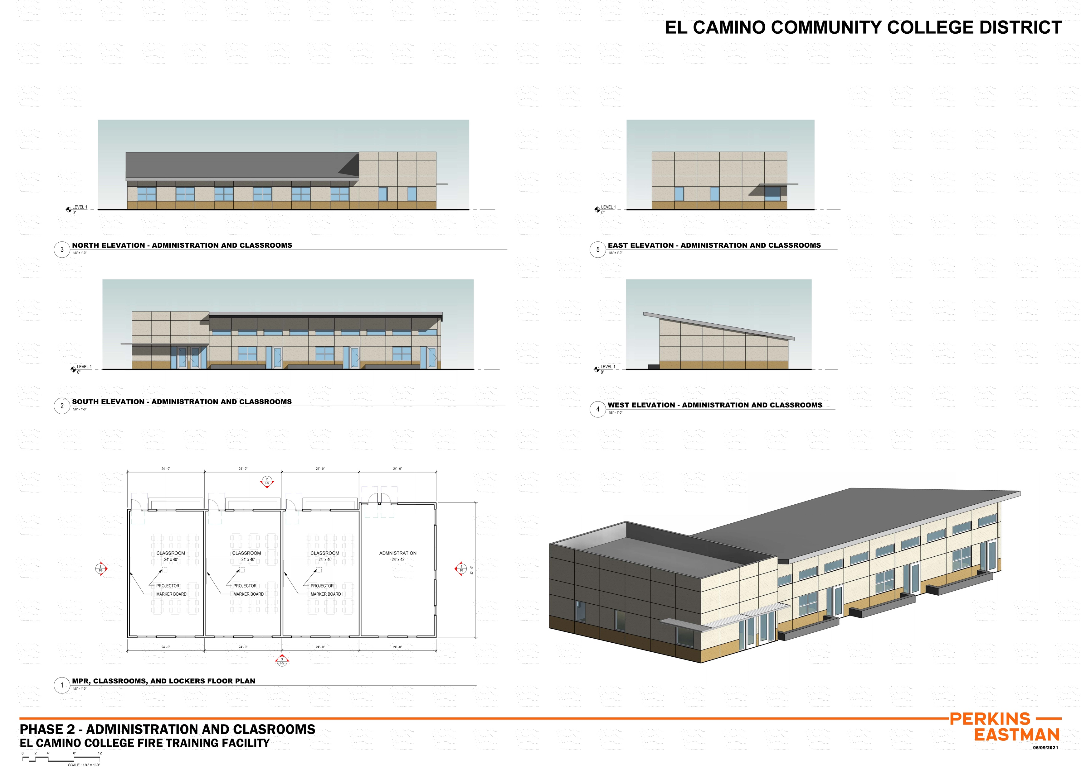

Slide 10
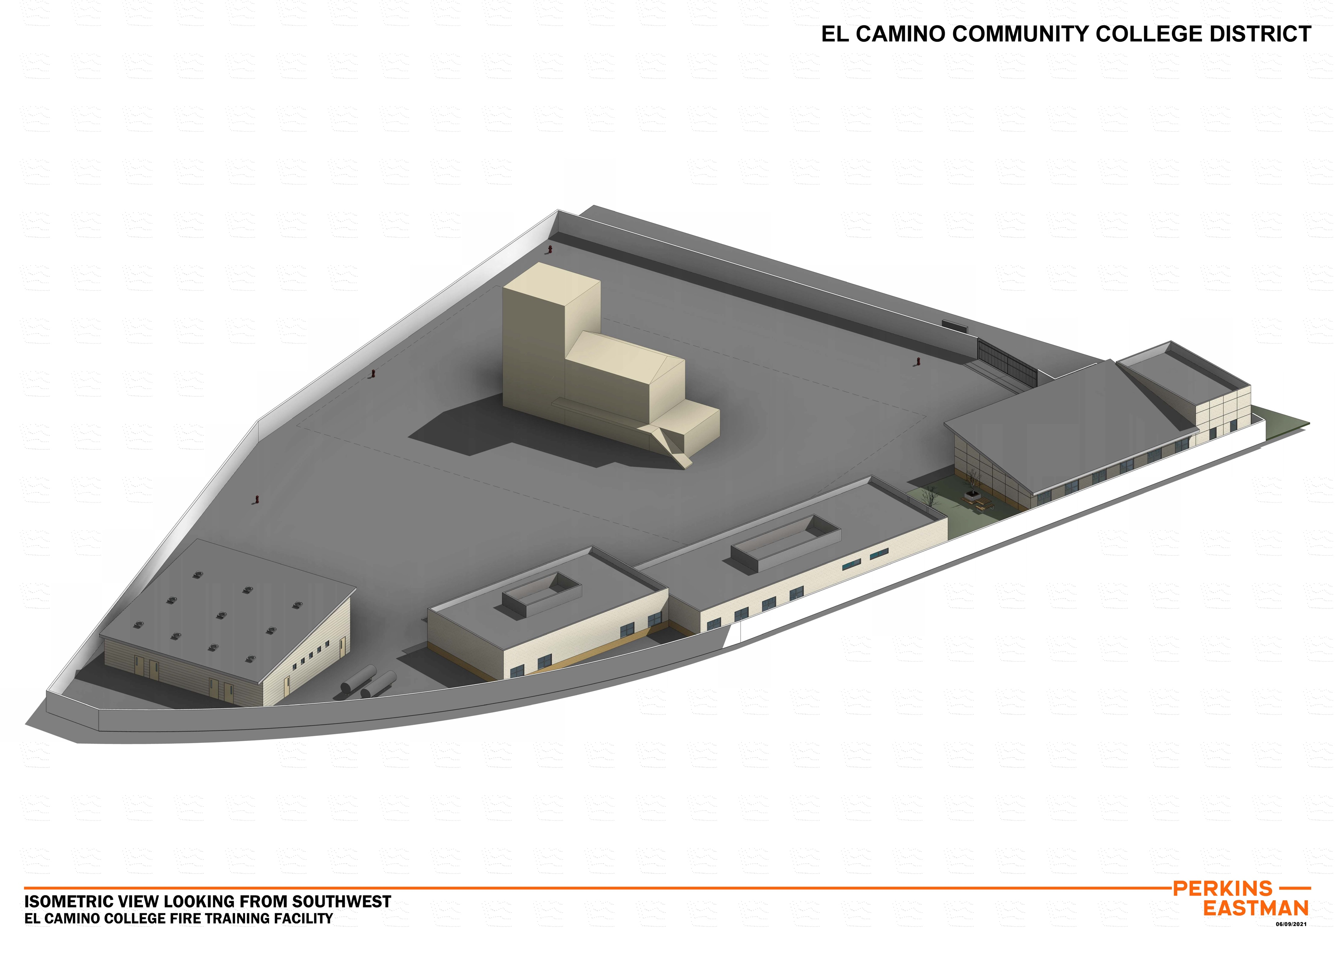

Slide 11
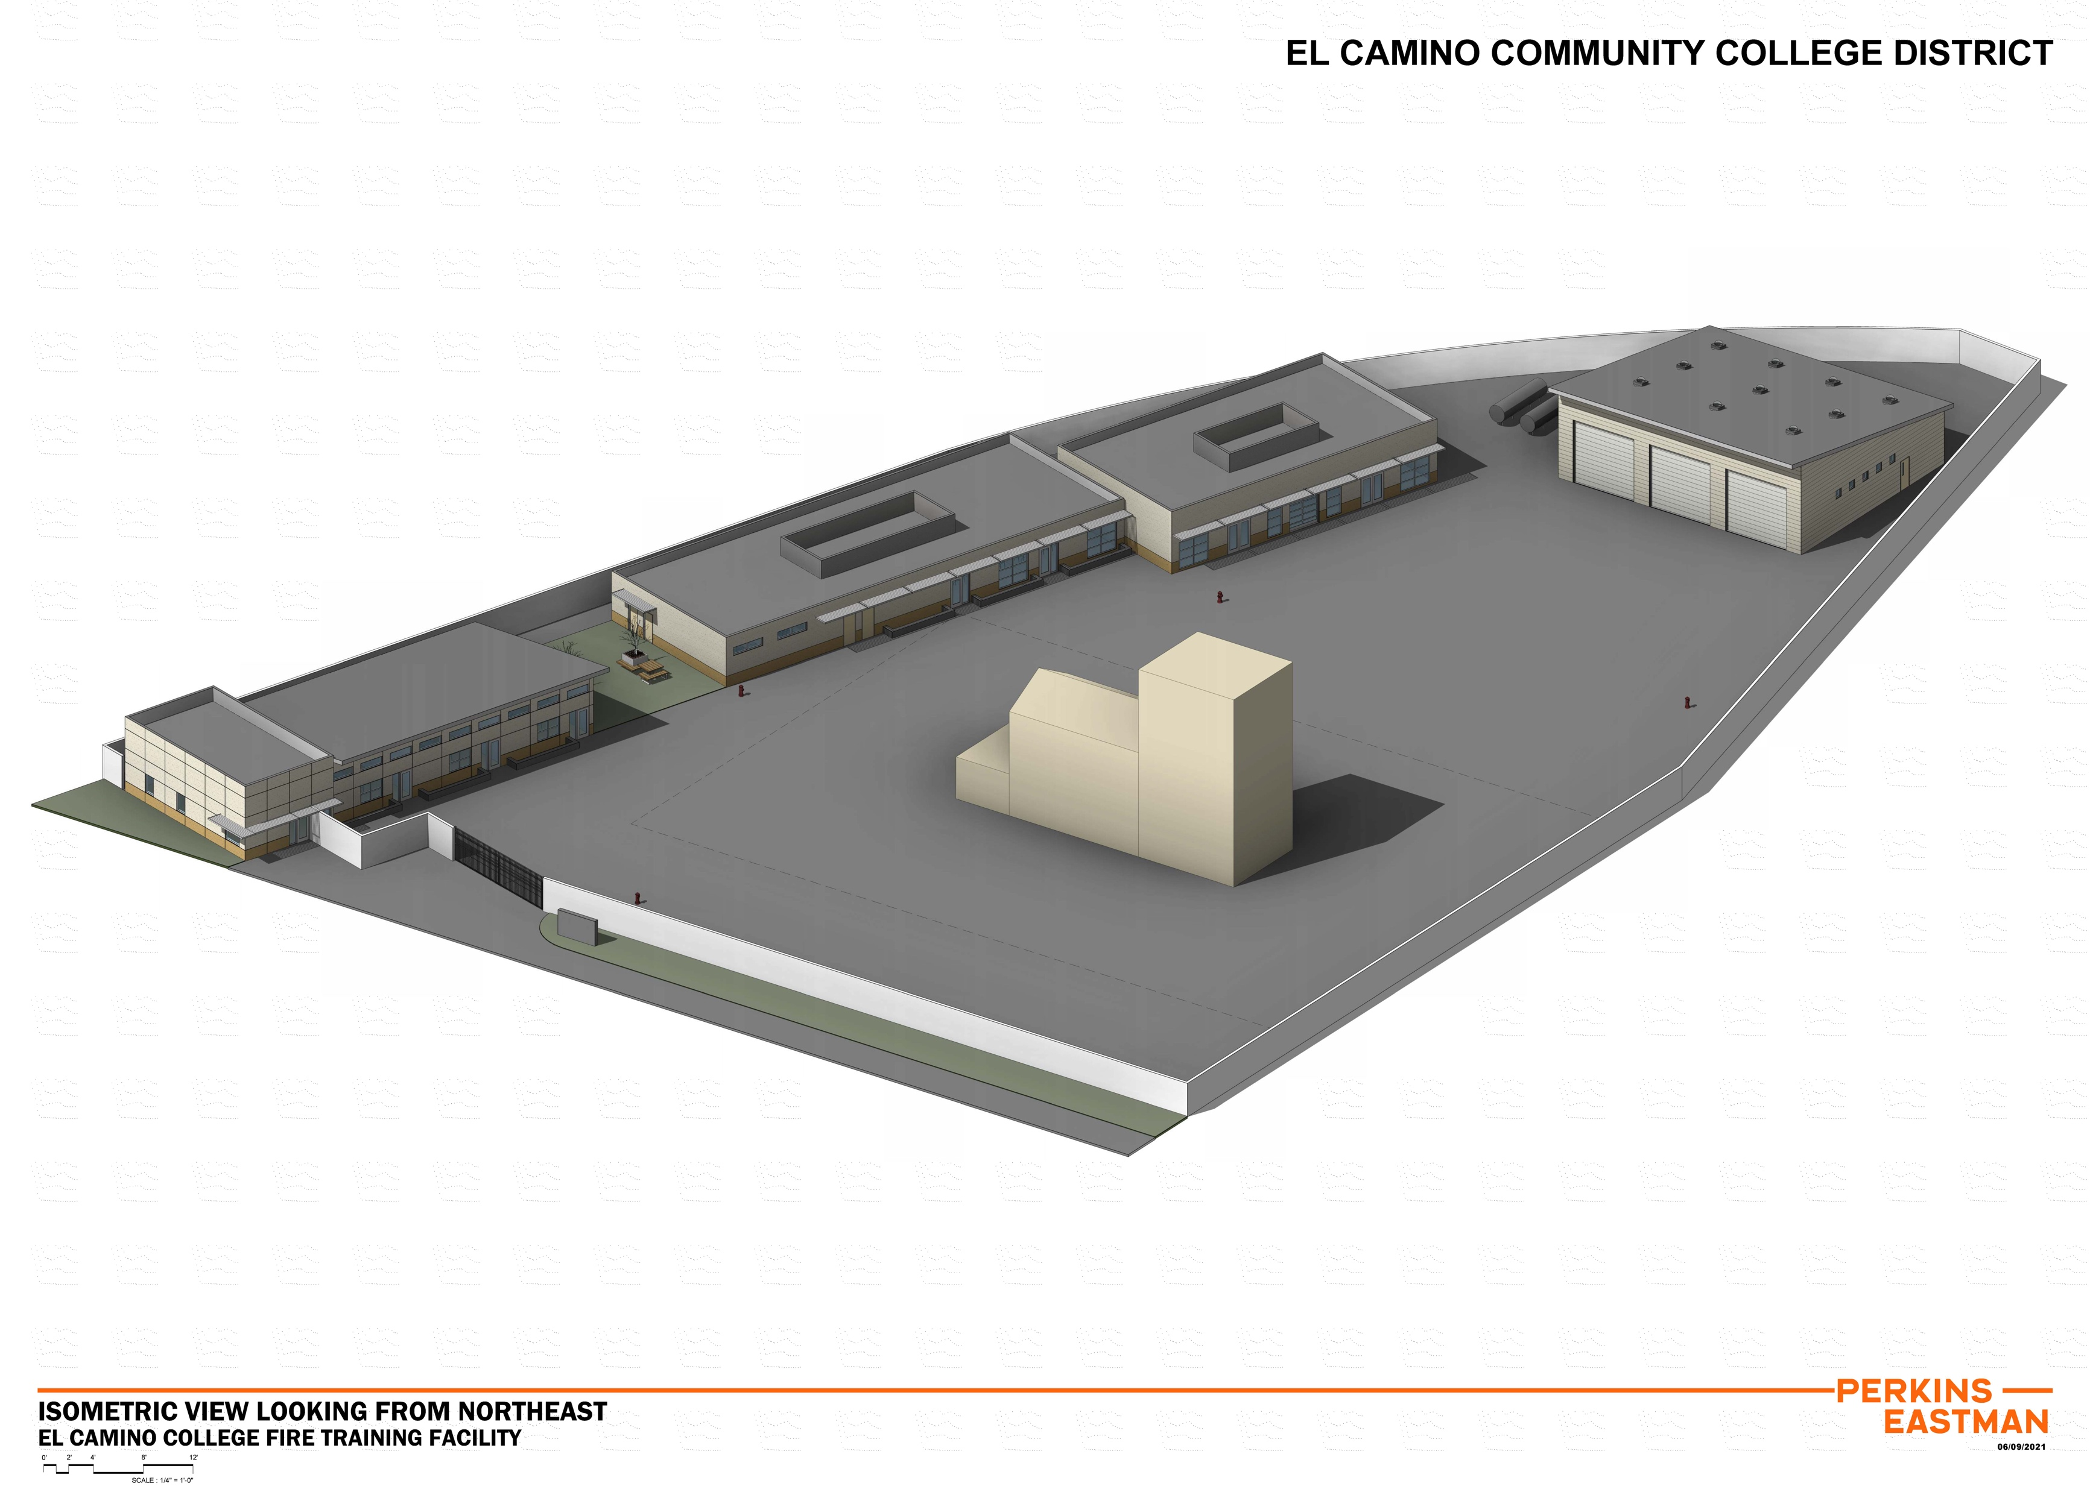

Slide 12
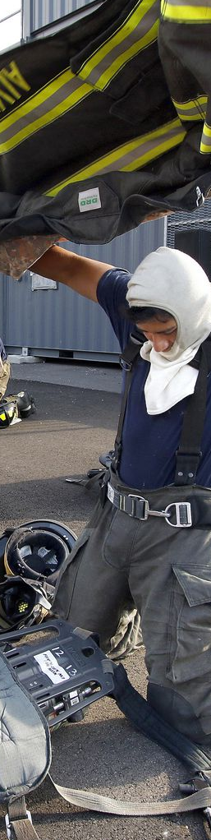
Typical Day at PSTC
0600-0700: Student Arrival
0700: Flag Detail
0730-0830: Physical Fitness
0900-1200: Classroom or Training Ground
1200-1300: Lunch
1300-1600: Classroom or Training Ground
1600-1700: Clean Up

Slide 13
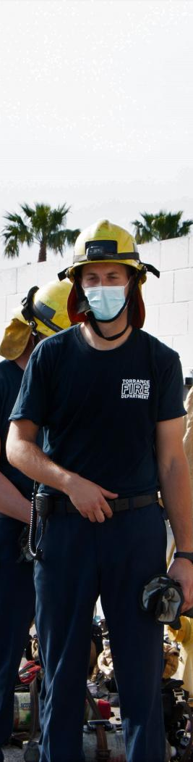
The Benefits
South Bay Fire Departments Stay Local
Faster Emergency Response Times
More Firefighter / EMT Training Opportunities for South Bay Departments
Helps Attract the Best and Brightest to South Bay Fire Departments
Local Recruits Can Train Nearby
Open House / Field Trip Opportunities for the Public

Slide 14
The Timeline (Phase 1 Estimate)
JULY 2021
Community outreach, stakeholder review
begins
JUNE 2022
Division of State Architect Approval
AUGUST 2022
Construction begins
1
3
5
2
4
6
February 2022
Agency review
(Division of State Architect)
AUGUST 2022
Bidding, contract award
MARCH 2023
Public Safety Training Center opens

Slide 15
Questions?
To make comments or for more information:
publicsafetytrainingcenter@elcamino.edu

