Slide 1

Sociology Department Meeting
Tuesday, September 9, 2025

Slide 2
Sociology Department - Agenda
MINUTES: In red text in boxes within the PowerPoint.
Attendance: Stacey Allen, Melissa Fujiwara, Martin Leyva, Kassia Wosick, Mediha Din, Jeffery Inada, Veronica Casillas (Counselor), Chris Gold.
Fall Enrollment and Scheduling
SLOs – Kassia
Curriculum
Funding for Speakers/Presenters?
Funding to Pay PT Faculty for PD Day?
Student Expo and Career Night Representation
Careers in Sociology
Program Review
Counselor’s Report – Veronica Casillas

Slide 3
Sociology Enrollment – Spring 2022-25
Enrollment fell in Spring 2025, likely because of fraud.
31 Sections
71% Fill Rate
36 Sections
76% Fill Rate
35 Sections
88% Fill Rate
39 Sections
74% Fill Rate

Slide 4
Sociology Enrollment – Fall 2022-25
Enrollment has shown continued growth in Fall. Fill rates are high this spring. Two second 8 week sections were added after this data was collected to fill ongoing demand. A list created by Counseling shows SOCI 101 as having one of the largest #s of students on the waiting lists after the 16 week add period ended.
34 Sections (AS OF SEPT. 9)
95% Fill Rate
34 Sections
80% Fill Rate
34 Sections
96% Fill Rate
31 Sections
82% Fill Rate

Slide 5
Women’s Studies Enrollment – Fall 2022-25
Women’s Studies 101 has shown overall declining enrollment in the past 5 years. It grew from 2 sections to 6, and then demand has declined to 4 sections.
4 Sections (AS OF SEPT. 9)
91% Fill Rate
6 Sections
89% Fill Rate
4 Sections
94% Fill Rate
5 Sections
82% Fill Rate

Slide 6
SLO’s - Kassia
The Spring SLOs are mostly finished. The glitch with SOC 104 and 108 has been fixed. Kassia will enter 104 and 108 into the Google spreadsheet and then SOCI will be 100% compliant for Spring 2025. WSTU assessment should be delayed this Fall because of Program Review.
Message from Eduardo, the SLO Maestro
The department is working towards submitting their Spring 2025 assessments results and analysis on time. Having said that, there appears to be a minor glitch in Nuventive related to 2 Sociology courses. The Nuventive administrators have been made aware of it and are working to get it resolved. As far as this semester goes, the department is conducting Program Review so there are no SLOs scheduled for assessment.

Slide 7
Curriculum
Martin covering for Melissa on the Division Curriculum Committee in Fall 2025. Martin will go the meetings and Melissa will do the approvals.
Sociology 101 SOCI C1000 and Sociology 101H SOCI C1000H – These two courses are part of phase three and do not need to be created this Fall.
Sociology 108
Sociology 112

Slide 8
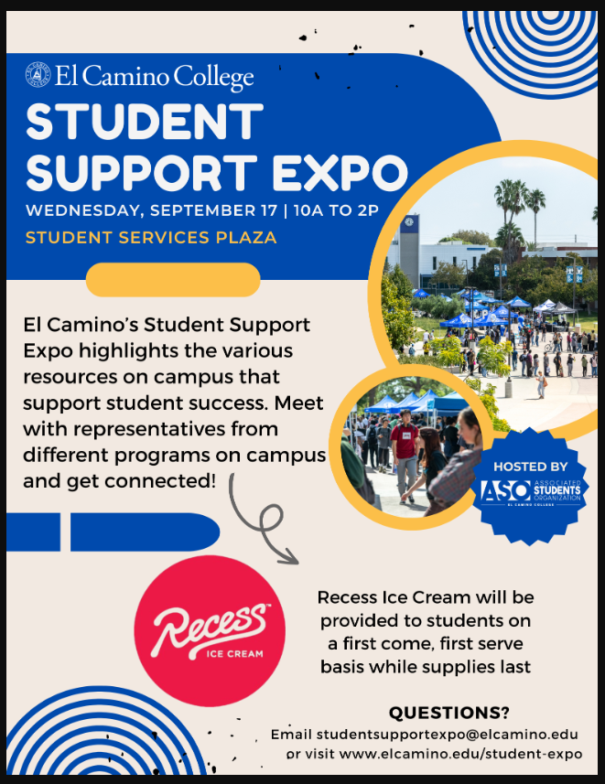
Departmental Topics
Funding for Speakers/Presenters – The division has some limited funding for speakers. The department may want a speaker on AI and equity issues.
Funding to Pay PT Faculty for PD and Presentation – PT are paid for up to about for hours of professional development.
Student Expo (9/17/25), Career night, and College night (Nov. 5) representation - Martin likes to attend these. They may need some “Oomph” for the table. Martin will update the flyers.
Program Review – The goal is to have a draft by mid-September and to then circulate it for review.

Slide 9
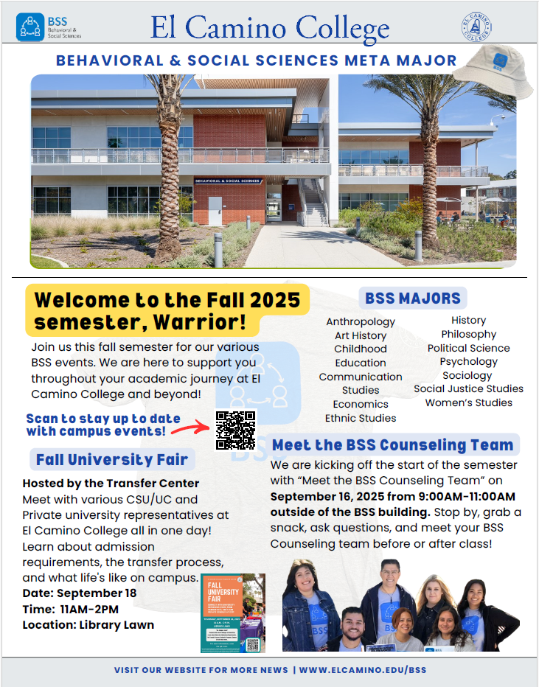
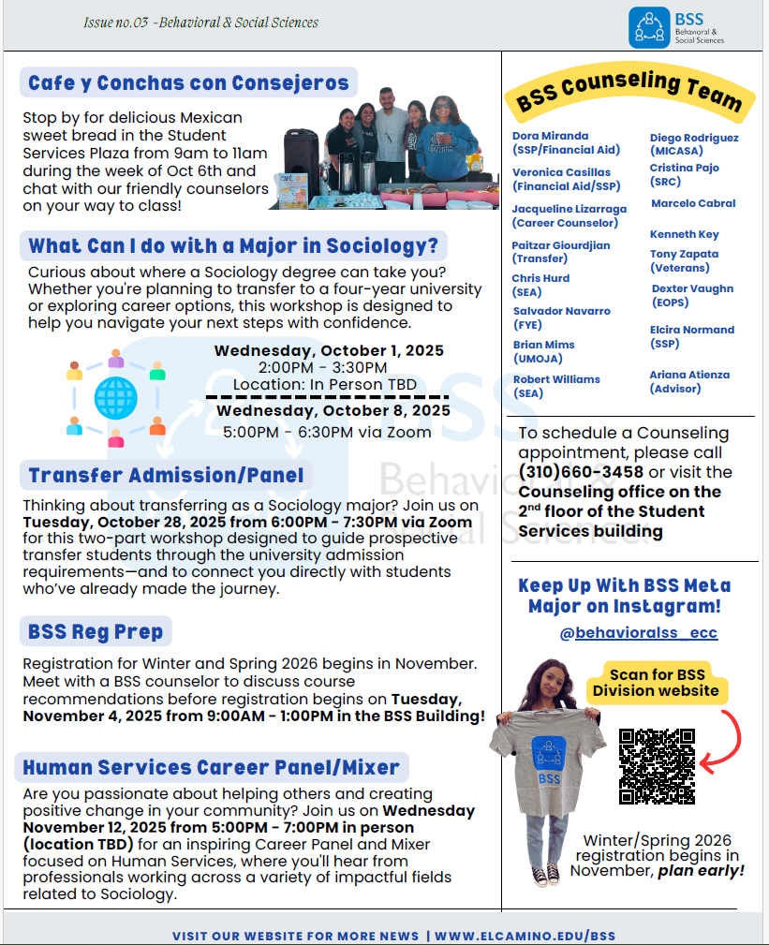
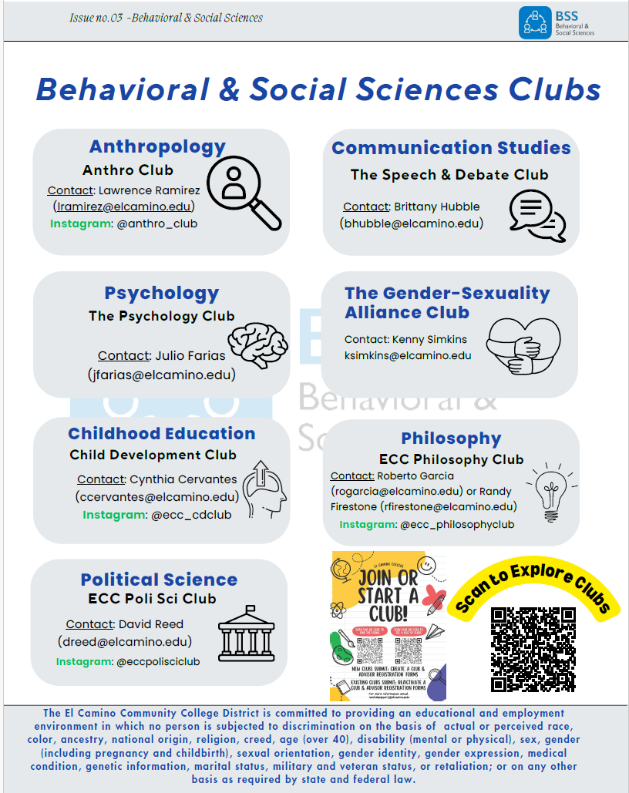
Counselor’s Report – Veronica Casillas
The BSS Counselors are focusing on Sociology this semester. They are going to hold a “What Can I do with a Major in Sociology” event on Oct. 1 in person and Oct. 8 on Zoom.. They have consulted with the Sociology faculty on it.

Slide 10


