Slide 1
Academic Senate Meeting
5-2-23

Slide 2
Quick Reminder
Comments/questions not directly related to current agenda item will not be acknowledged until public comment. Additionally, comments/questions on agenda items should contribute to the discussion in a meaningful way. Public comments will be limited to 1 three-minute comment per person per meeting.
The Academic Senate fully respects the time of all our senators and other meeting participants. With this in mind and because of the many items within senate purview that must be addressed each semester, we ask that discussions in senate meetings, even during the public comment period, be limited to topics within/related to the 10+1 purview of the Academic Senate. If your comment is completely unrelated to senate purview (i.e. topics such as salaries/wages, and benefits), you will be kindly asked to hold your comment and advised as to a more appropriate venue to have the conversation.

Slide 3
Approval of the Minutes from (4-18-23) Packet pages: 6-13

Slide 4
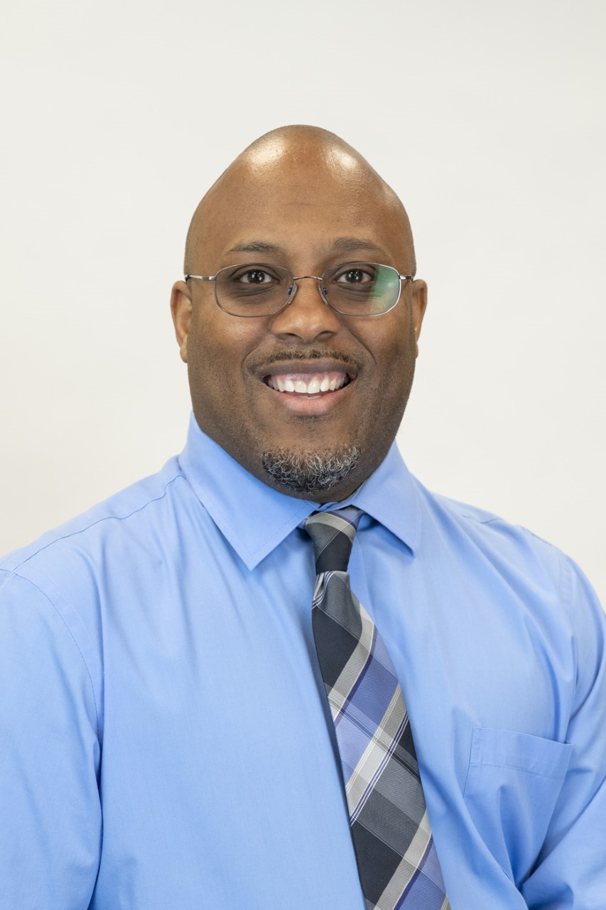
Welcome Dean's Representative!
Dr. Marlow Lemons Dean of Mathematical Sciences Preferred Pronouns: He/Him/His Exciting Things: Data Science/Data Analytics Week (this week); Just In Time Workshops (Tuesdays and Thursdays for students)

Slide 5
Unfinished Business

Slide 6
Academic Senate Executive Board Elections
VP Academic Technology
Stephanie Burnham
VP Educational Policies
Darcie McClelland
VP Equity, Diversity, and Inclusion
Erica Brenes
VP Faculty Development
Anna Brochet
VP Finance and Special Projects
Josh Troesh
VP Logistics and Communications
Maria Garcia

Slide 7
Resolution in support of faculty input in technology needs
Packet page 14

Slide 8
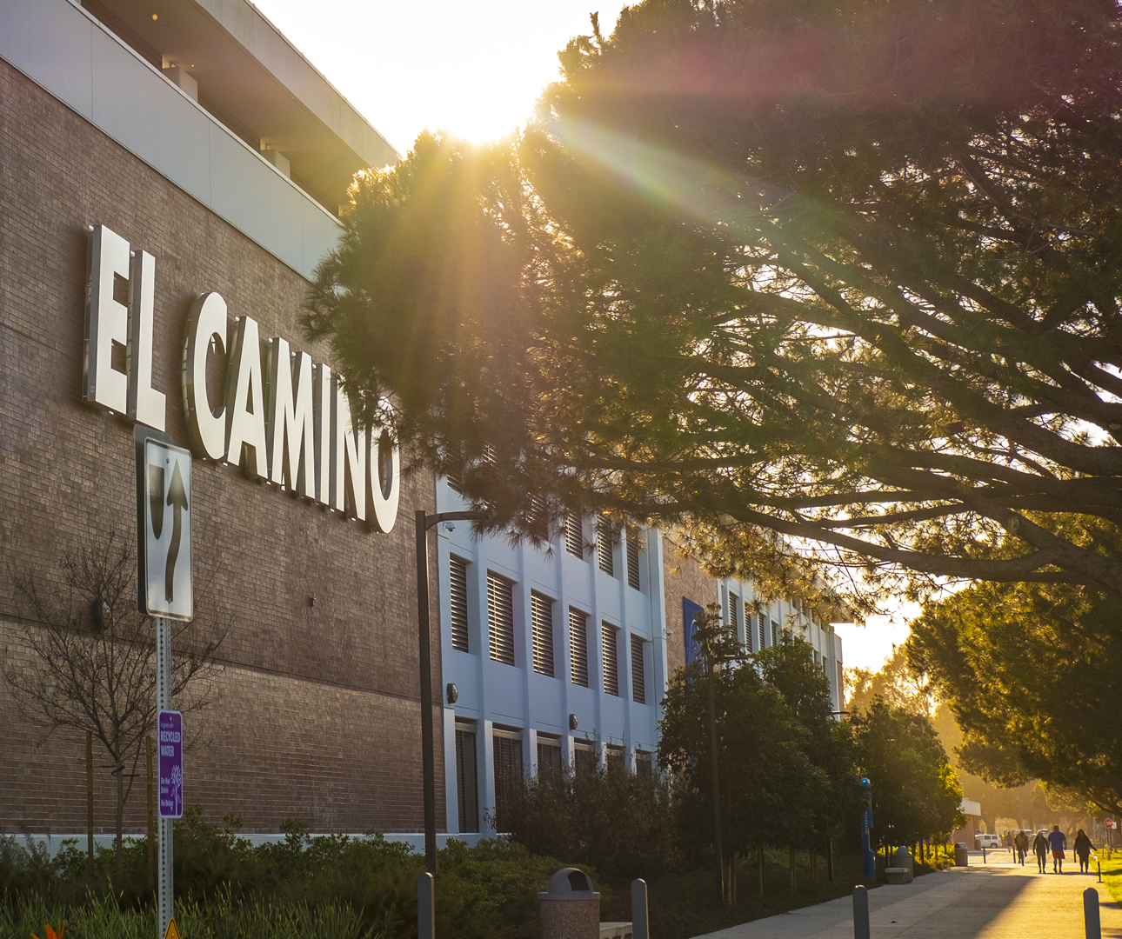
New Business

Slide 9
Counseling Faculty evaluation form revisions
Packet pages 15-24

Slide 10
BP/AP 4045, Instructional Materials
Packet pages 25-28

Slide 11
Letter to CIP re: Child Development Center
Packet page 29

Slide 12
Academic Senate Constitution Changes
Packet pages 30-44

Slide 13
Information Items

Slide 14
Faculty Development Announcements
Save the Date for Fall PD Day!: Thursday Aug 24, 2023
Call out for PD Power up Month Virtual Sessions (8/7-8/23) and Conversations with Colleagues Table Topics due May 12th
Please complete Faculty Professional Development Needs Assessment by Friday, May 5th
Informed and Inspired, Linguistic Justice
Panel followed by Discussion: Thursday, May 11, 1:15-2:45pm via Zoom
College Book Club, Fridays 11am-12pm:
May 19

Slide 15
Equity, Diversity, & Inclusion Announcements
Save the date for our next committee meeting: 5/10 3-4PM on zoom, particularly if you have ideas for how to develop, fund, and support an equity summit for Fall 2023
You can now submit ideas in advance!
You can now nominate EDI champions in preparation!
See the new EDI campus website
Please see the packet for the full report.

Slide 16
Officer Announcements

Slide 17
Curriculum Announcements
Please see the packet for the full report.

Slide 18
Educational Policies Announcements
Please see the packet for the full report.

Slide 19
Finance Announcements
Please see the packet for the full report.

Slide 20
Academic Technology Announcements
Please see the packet for the full report.

Slide 21
Instructional Effectiveness Announcements
Please see the packet for the full report.

Slide 22
Special Committees

Slide 23
Academic Affairs

Slide 24
Student Services

Slide 25
Public Comments

